Slide 1
Genius hour:
My First Game

Slide 2
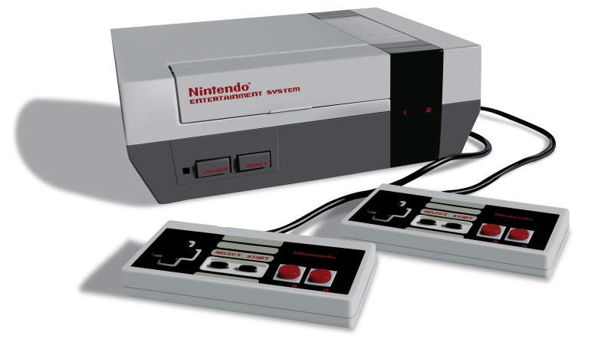
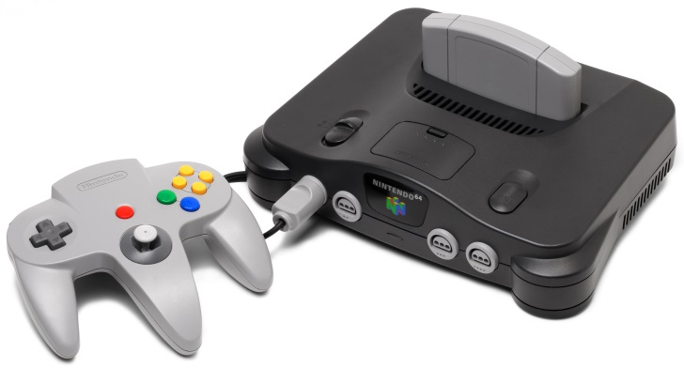
what
The 8-bit game I made is for the Nintendo Entertainment System (the grey box on the bottom).
It uses the 6502 microprocessor, which requires the coding language “assembly”.
The term “8-bit” refers to how complex the numbers are in the system. So, the NES would be able to handle 8 numbers of binary. (Nintendo 64= 64 numbers).
01011010
011001000101011110010…
<

Slide 3
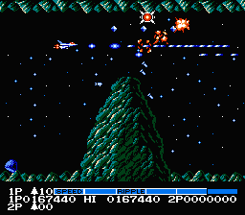
why
I wanted to make a game because it followed a hobby of mine, and my wannabe job is to develop them.
I made it for the NES because since it was my first game, I didn’t want it to be too difficult for me to finish.
Finally, I made it a horizontal shooter because I wasn’t skilled enough to make a platformer, but I didn’t want something basic like a puzzle game.
Lastly, it is a Lord of the Rings game simply because I’m a fan of the series.

Slide 4
beginning
My first step was learning the language.
Not many people I knew could code assembly, let alone for this one system, so I decided to go solo.
There were lots of websites and books about the 6502 assem. language that I would have been stranded without.
Also lots of websites/tutorials were available that focused specifically on the NES using this language which I would have been even more stranded without. (nesdev and nintendoage, to name a few).
Ex--adding 1 to a number in assembly:
LDA $0035
CLC
ADC #$01
STA $0035

Slide 5
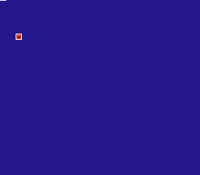
creating
After getting comfortable with the language, I started the tutorials of the basics.
I filled out the basic structure to making a game, and created my first ever program.

Slide 6
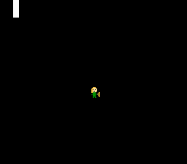
creating
Then, I advanced and worked on things such as displaying sprites and moving them, and implying a system to increase your score.
The forums of the sites with tips from experienced developers helped out immensely.
This was also the point where I started legitimately designing the game.

Slide 7
creating
Next, was making backgrounds, displaying your score, credits, and scrolling.
This is where things started to get hard, as I got stuck on backgrounds for a long time, and scrolling for even more.
Another thing to add is that the more complex the code is, the more room there is for game-breaking errors.
I was at the point where I had to rewrite some parts to match up with others.

Slide 8

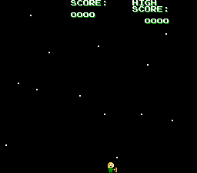
creating
Proceeding was adding enemies, moving those, and adding an ammo system.
I tried to shove all of these features in without taking breaks, anticipating to finish.
This resulted in an abundance of incorrect code and lots of broken builds.
It messed with my code so severely that I had to start almost from scratch, and review over the old books I read before continuing so this wouldn’t happen again.
☹
☺

Slide 9
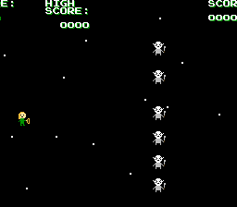
creating
After a few months of studying and reading tips/forums/tutorials, I finally caught up to where I previously was with better, more effective code.
Taking caution and frequently checking for problems, I successfully added moving enemies and ammo.
I also had a fully working title and credits screen thanks to my improved skills in programming.
This whole debacle revealed to me that the key to a working, complete game was taking your time and checking every detail to see if x works with y.

Slide 10
creating
Going on, I advanced to enemy collision, ammo collision, and game overs.
A mistake I made making these components was lengthy code sections.
After investigating, I found that there was a much smaller way to perform these. Another slip-up I made was forgetting to direct my code back to where it was.
I learned another key of making a game from these experiences, that being to take shortcuts and always follow the path of your code.

Slide 11
finishing
The last factors I had left were bonuses and sound, which were one of the easiest ones to add.
I bought a tool to use with my own controller that would connect it to a computer.
After editing some minor details and running some tests of the code, I assembled my final copy of the game.

Slide 12
Tools/Software I used
Programmer’s Notepad
NESASM3
YY-CHR
FCEUX NES Emulator
Tile Pro Layer
Nestopia
Notepad

Slide 13
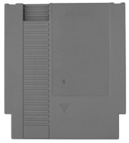

Things I couldn’t do
I couldn’t put the game in a physical form. Some of the required parts were too expensive, another out of stock, and one more having shipping problems.
Because of this I am using an emulator (something that directly emulates the hardware of an NES), even thought I would’ve preferred the real deal instead of using a computer.
A lot of features in a fully-fledged game I just couldn’t add for time and skill reasons (animation, music, levels, bosses).
There are also still may be some minor bugs.

